Slide 1
Lucky Unicorn Documentation
Joshua Bracefield

Slide 2
Lucky Unicorn
Link to GitHub Repository: https://github.com/joshbatmiddleton/Lucky-Unicorn
Links to Trello board / project management tools: https://trello.com/b/4ApV5W8c/decomposition
Link to final version of your program: [here]
Ensure you have made these links ‘public’ so that they are open to anyone, including the marker. The link to your program is the final outcome of this whole project – your finished program.

Slide 3
Describe relevant Implications:
Additional rows can be added by clicking in the last cell and then using the Tab key
Relevant implication | Describe the implication and give an example
Functionality | Functionality is about making sure your program works the way you have designed it, and that it functions the way you made it.
Usability | Usability is about making sure that the program is easy to use, and that the program can do what it needs to do
Aesthetics | Aesthetics is about what and how your program looks. If a program looks good, it will function with the intent that you have. If it doesn't look formatted, you might find several errors in the code
Social | Social is about the outcome of your program affects the users of it, and the community/society.
Notes:
Additional rows can be added by clicking in the last cell and then using the Tab key

Slide 4
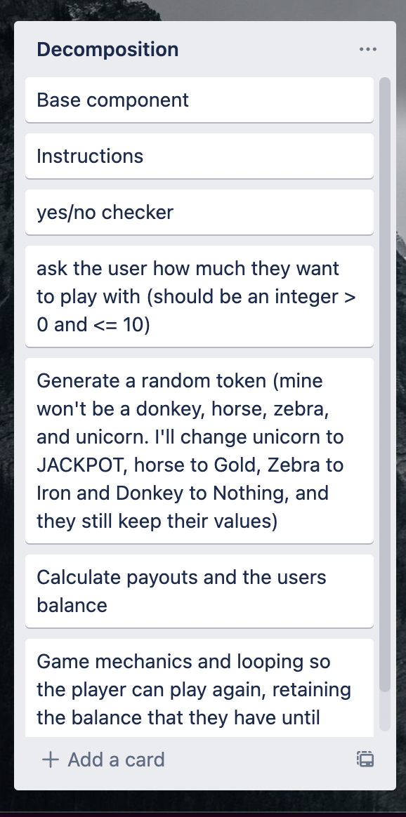
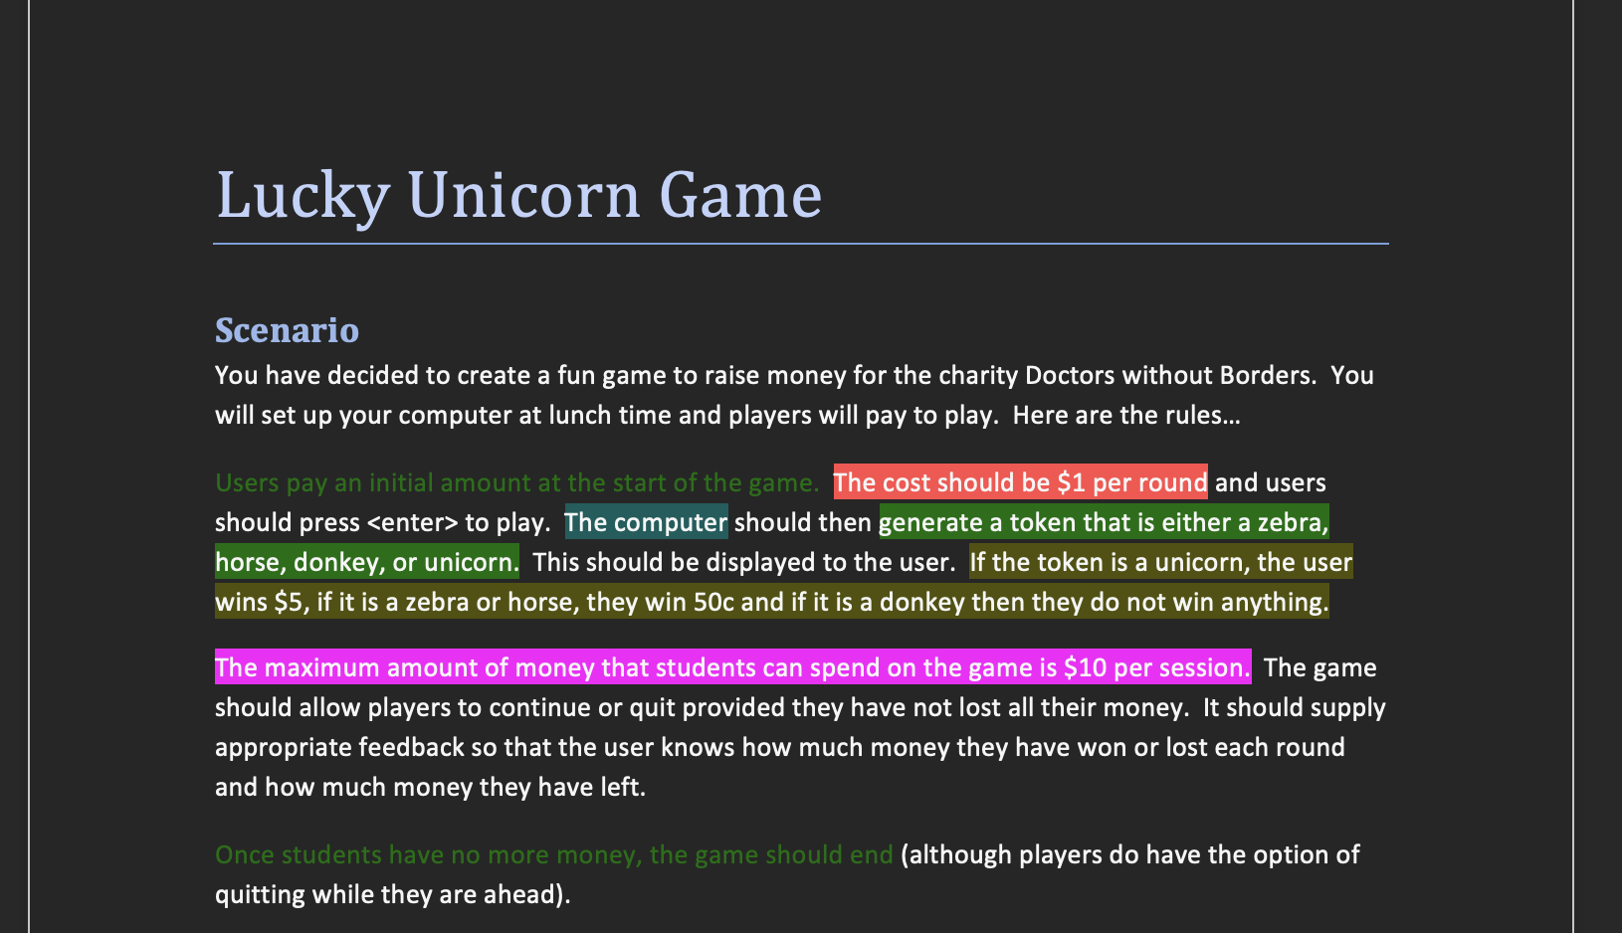
Decomposition:
Paste screenshots of your initial Trello board / task decomposition on this slide. If you have a long list, you might need to break it up into several slides.
Notes:
Paste screenshots of your initial Trello board / task decomposition on this slide. If you have a long list, you might need to break it up into several slides.

Slide 5
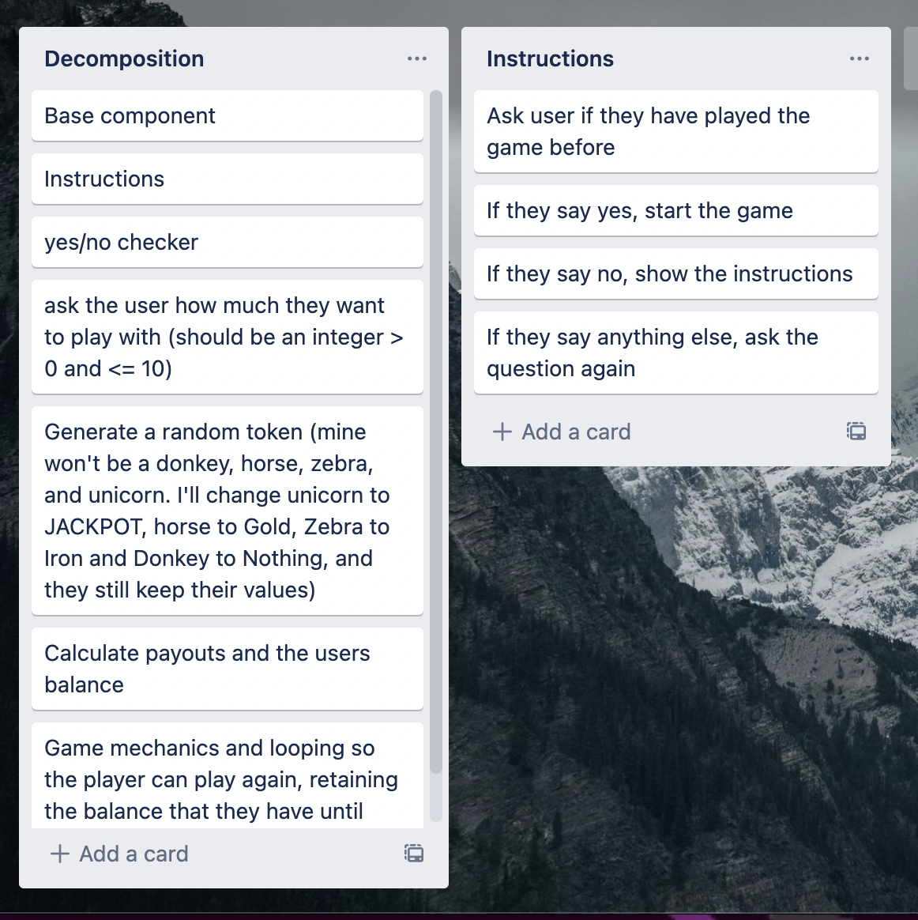
Component 1 (Instructions and Yes/no checker)

Slide 6
Yes/No checker - Test Plan
Additional rows can be added by clicking in the last cell and then using the Tab key
Test Cases - input | Expected output
yes | Program continues
no | Program continues
Yes | Program continues
No | Program continues
Y | Program continues
N | Program continues
maybe | Program continues
Maybe | Please enter either “Yes” or “No”.
Notes:
Additional rows can be added by clicking in the last cell and then using the Tab key

Slide 7
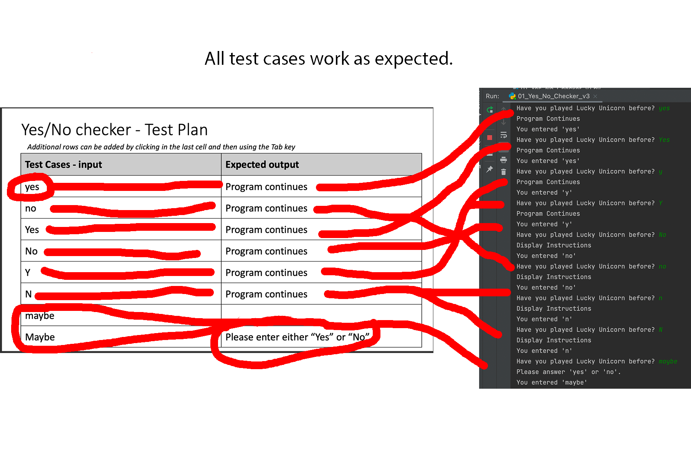
Yes/No Checker: Testing
Notes:
You must show the results of testing. For each component, include a screenshot proving it works. You can also include notes about each test.

Slide 8
Instructions - Test Plan
Additional rows can be added by clicking in the last cell and then using the Tab key
Test Cases - input | Expected output
Have you played before? Yes | Game starts
Have you played before? No | Instructions show, then game starts
Have you played before? Maybe/anything else apart from yes or no | Shows an error saying, "Please enter Yes or No"
Notes:
Additional rows can be added by clicking in the last cell and then using the Tab key

Slide 9
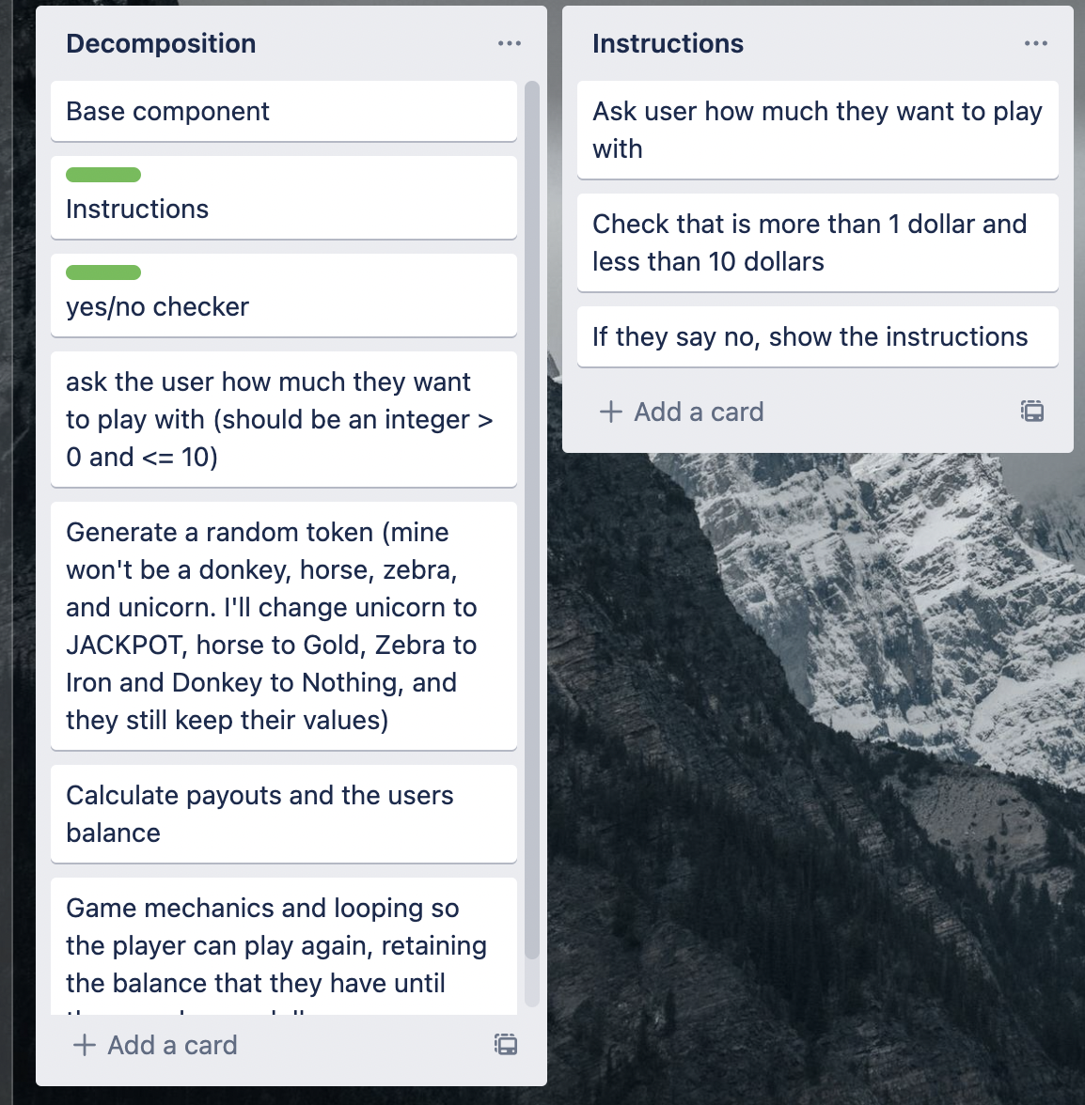
Component 2 (How Much)

Slide 10
How much - Test Plan
Additional rows can be added by clicking in the last cell and then using the Tab key
Test Cases - input | Expected output
xxii (invalid – string) | <error> Please enter a whole number between 1 and 10
0.5 (invalid – float) | <error> Please enter a whole number between 1 and 10
0 (invalid – too low) | <error> Please enter a whole number between 1 and 10
11 (invalid –too high) | <error> Please enter a whole number between 1 and 10
1 (lower boundary) | Program continues
10 (upper boundary) | Program continues
Notes:
Additional rows can be added by clicking in the last cell and then using the Tab key

Slide 11
[Component name]: Trialling
NOTE: Trialling needs to happen for at least 2 of your components but is not necessary for ALL components.
Trialling is not the same as testing. Trialling is about finding different ways of building the same component. Show evidence of your trialling here. Select one of your trials for further development and give reasons for your choice.
Notes:
NOTE: Trialling needs to happen for at least 2 of your components but is not necessary for ALL components.
Trialling is not the same as testing. Trialling is about finding different ways of building the same component. Show evidence of your trialling here. Select one of your trials for further development and give reasons for your choice.

Slide 12
Assembled Outcome Testing:
Show testing for your assembled outcome below. This should include a test plan followed by screenshot proof.
Notes:
Show testing for your assembled outcome below. This should include a test plan followed by screenshot proof.

Slide 13
Address relevant Implications:
Relevant implication | Explain how your final outcome addresses each implication

Slide 14
Version Control Evidence:
Your version control evidence should go here. This could be in the form of screenshots (both of your GitHub repository as well as your local project folder) as evidence of your incremental development.
Notes:
Your version control evidence should go here. This could be in the form of screenshots (both of your GitHub repository as well as your local project folder) as evidence of your incremental development.

Slide 15
Final Discussion:
Discuss how the information from planning, testing and trialling of components assisted in the development of a high-quality outcome.
Notes:
Discuss how the information from planning, testing and trialling of components assisted in the development of a high-quality outcome.

